Slide 1
The ChapR

Slide 2
What is the ChapR?
A remote for controlling FTC robots without a PC
Small, portable device with 2 USB connectors for the joysticks
A device to release waitForStart() on any program running on the brick

Slide 3
Features
Pocket-size
2 USB connectors for the joysticks
waitForStart() release
Connects to the last known NXT brick upon boot

Slide 4
Giving Back to the Community
Allow less fortunate teams to demo, test and practice driving without needing multiple PCs
The profits made will be used to give ChapRs to teams in need (every 1 in 4 or 1 in 5 ChapRs will be free)

Slide 5
What do we need?
A 501c3 non-profit organization to accept money and assure people that they won’t have to pay taxes
An organization to order parts and store excess profits that will go toward giving out free ChapRs

Slide 6
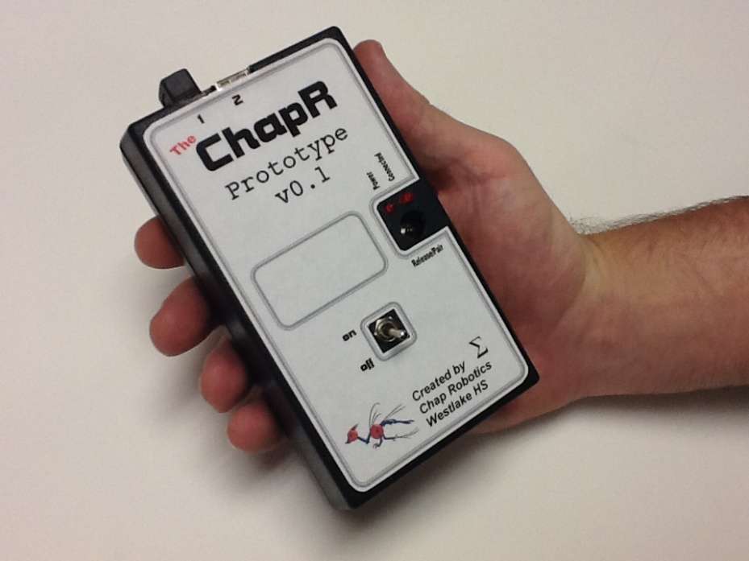
Design - Case
3D printed

Slide 7
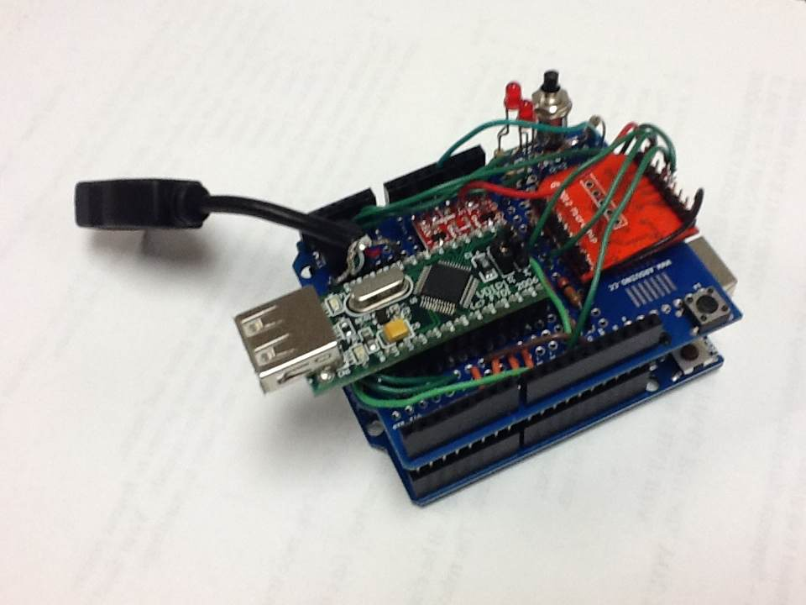
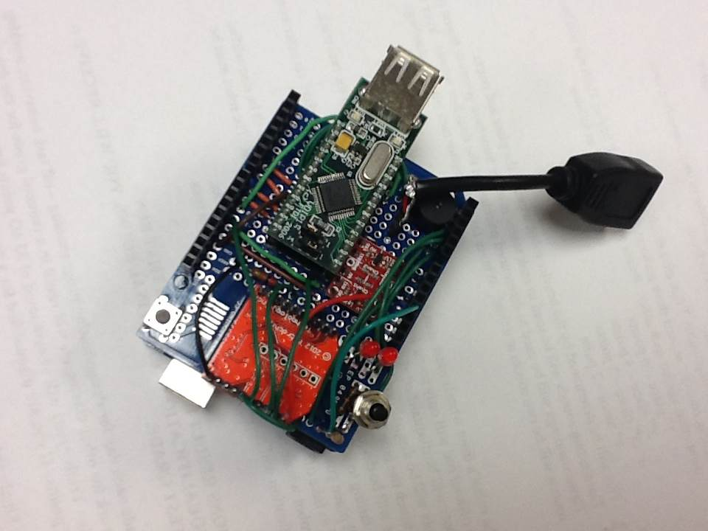
Design - Hardware
Arduino Mini
VDIP (2 USB ports which receive joystick input)
LEDs (one red and one blue)
Speaker (to transmit information to the user)
Button (to make the ChapR bluetooth discoverable or release a waitForStart)
Bluetooth module (which sends the joystick input to the NXT)

Slide 8
Design - Software
Runs on the Arduino Mini
lowPower mode
Entered when the ChapR receives no joystick information for a period of time
Doesn’t transmit via Bluetooth, but resumes normal function upon joystick input
zombieMode
Entered when the ChapR receives no data for a long period of time
Shuts down entirely and must be rebooted

Slide 9
Timeline

Slide 10
Promotion
FTC World Championships
Assessed interest level (8.5 out of 10)
Tested the prototype (1st time connection needed work, but worked beautifully from then on)
Commercial
Highlights problems without the ChapR (in 3 scenarios)
Explains how the ChapR solves each
Demoes the ChapR

Slide 11
Future Promotion
Outtakes
Comedic relief on the website/youtube channel of our attempts to make a commercial
“Appisodes”
Scenarios where the ChapR is needed (and/or comes in to save the day)
Australia
Sending a prototype to the Asia Pacific Qualifier for some overseas exposure

